Slide 1
CSS
Styling boxes

Slide 2
overflow: content doesn’t fit Box
overflow: visible -> content show even if too large for box
overflow: hidden -> overflow never shown
overflow: scroll -> always scrollbars present
overflow: auto -> scrollbars only shown if content too large for box
http://www.w3schools.com/cssref/pr_pos_overflow.asp

Slide 3

overflow: hidden;

Slide 4
CSS3 blok manipulations
transforms
Older browser versions need prefix:
-moz- Firefox
-webkit- Safari en Chrome
-o- Opera
-ms- IE9
How can you take older browsers into account in your CSS?

Slide 5
CSS3 blok manipulations
2D transforms
translate(x,y):
Moves element x (hor) and y (vert)
rotate(xdeg):
Rotates element x degrees clockwise
scale(x,y):
width * x, heigth * y
skew(xdeg,ydeg):
Skews element x degrees along X-axis and y degrees along Y-axis
matrix():
Comination of previous transforms (6 parameters)

Slide 6
CSS3 blok manipulatie
3D transforms
rotateX(x deg):
Rotate element x degrees around its X-axis
rotateY(y deg):
Rotate element y degrees around its Y-axis
rotateZ(z deg):
Rotate element z degrees around its Z-axis

Slide 7
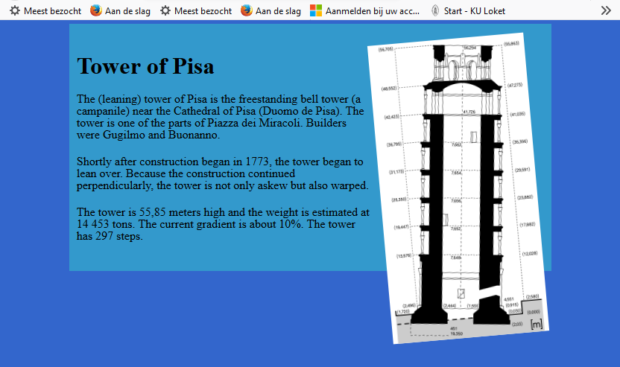
exercise tower of Pisa (reeks 9.1)
#39C
width: 75%
margin: auto
#3366CC
Rotated 5 degrees counter-clockwise
Mouse hover => rotated to 0 degrees

Slide 8
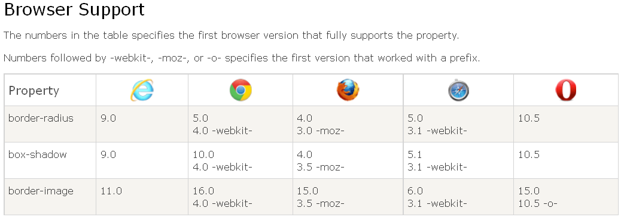
CSS3 borders

Slide 9
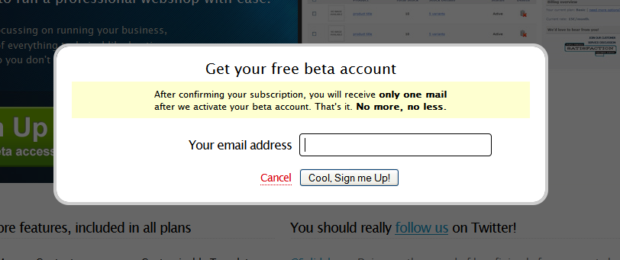
CSS3 borders
border-radius
Rounded corners
border-radius: 6px;

Slide 10

CSS3 borders
box-shadow
Syntax:
Box-shadow: h_shadow v_shadow blur spread color inset;
h-shadow | Required. The position of the horizontal shadow. Negative values are allowed
v-shadow | Required. The position of the vertical shadow. Negative values are allowed
blur | Optional. The blur distance
spread | Optional. The size of shadow
color | Optional. The color of the shadow. Look at CSS Color Values for a complete list of possible color values
inset | Optional. Changes the shadow from an outer shadow (outset) to an inner shadow

Slide 11


CSS3 borders
border-image

Slide 12
CSS3 borders
border-image
Syntax:
border-image: source slice width outset repeat;
Value | Description
source | The path to the image to be used as a border
slice | The inward offsets of the image-border
width | The widths of the image-border
outset | The amount by which the border image area extends beyond the border box
repeat | Whether the image-border should be repeated, rounded or stretched
Default: slice =100% (image completely inside box)
width = 1
outset = 0

Slide 13
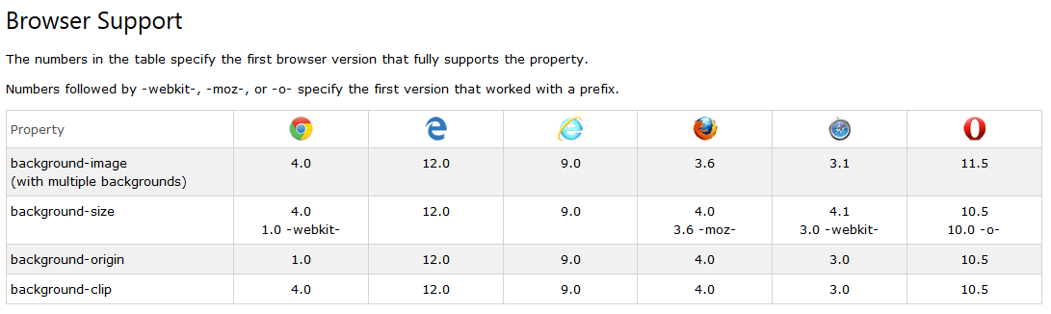
CSS3 backgrounds

Slide 14
CSS3 backgrounds
Background-size
absolute
relative
Background-origin
border-box
content-box
padding-box
Multiple backgrounds

Slide 15
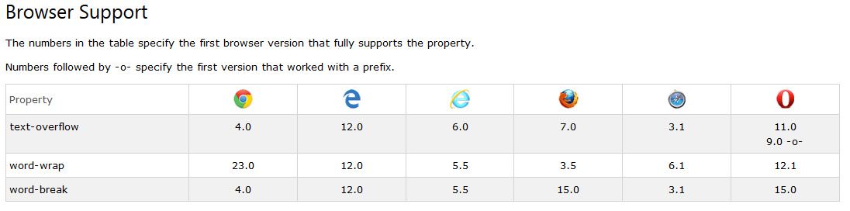
CSS3 text effects

Slide 16
example: FORM layout
<form action="#">
<fieldset>
<legend>Your personal data</legend>
<p>
<label for="name">Name:</label>
<input type="text" name="name" id="name" class="textfield" />
</p>
<p>
<label for="street">Street and no.:</label>
<input type="text" name="street" id="street" class="textfield"/>
</p>
<p>
<label for="ZIP">ZIP:</label>
<input type="text" name="ZIP" id="ZIP" class="textfield" />
</p>
<p>
<label for="hometown">Hometown:</label>
<input type="text" name="hometown" id="hometown" class="textfield" />
</p>
</fieldset>
<p>
<input type ="submit" value="Send" />
<input type ="reset" value="Reset" />
</p>
</form>

Slide 17
Form layout CSS
body{
font-family:Arial, Helvetica, Sans-serif }
fieldset{
width:22em;
margin:1em;
padding:1em;
border:1px solid #006699 }
label{
width:6em;
float:left;
text-align:right;
margin-right:0.5em }
input.textfield{
width:18em;
border:1px solid #999999 }
input.textfield:focus{
background-color:#FFFFCC;
border:1px solid #FFCC99 }

Slide 18
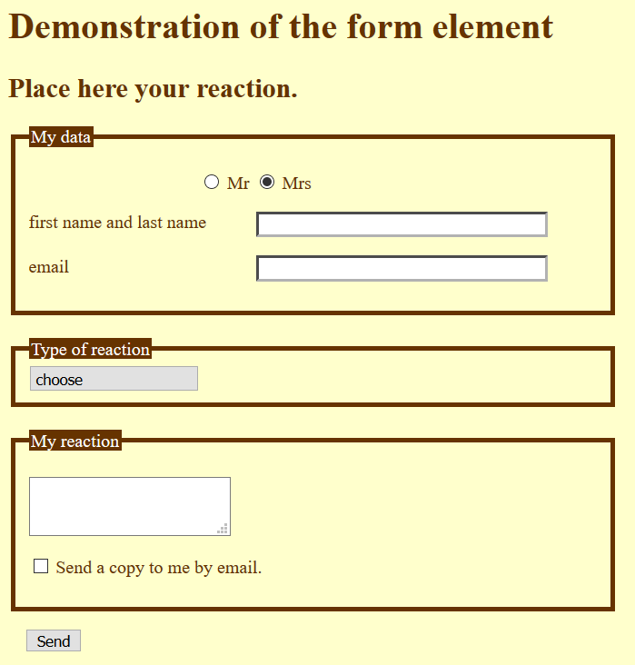
exercise: form layout

